Slide 1

C’est La Vie: The Game of Social Life
Created by Kosha D. Bramesfeld
Ryerson University
Notes:
Suggested script/ verbal description: Welcome! When thinking about a given person’s successes or failures in life, we can assume that those outcomes are probably due to a combination of internal factors (a person’s own motivation and hard work) and external factors (such as the conditions under which one is born, the social support that a person receives, or the ways in which the policies, rules, and reward structures of a society affect that person). Today we are going to start our class discussion with an activity that examines the relative balance between free choice and external factors in determining our outcomes in life.
Image from: https://openclipart.org/detail/188471/people---pessoas-by-leandrosciola-188471

Slide 2


C’est La Vie! A Game of Social Life
Part 1: Character profiles
Part 2: Strategy game
Part 3: Reflect, Discuss, Debrief
C’est La Vie!
The Game of Social Life
Pure Chance
Pure Strategy
Notes:
Suggested script/ verbal description: The activity includes three components: a character profile, an interactive strategy game, and a class discussion about the activity.
For the character profile, you will be given a description of the character that you will play during the game. The factors described are thought to represent factors that people are born with and have no control over in their lives. These factors include things like race, gender, socioeconomic status, disability, and sexual orientation. We also have no control over whether or not we are born into a wealthy, middle class, working class, or poor family. Nor do we have control over whether we receive proper emotional support and a safe environment as a child. Your character profile will contain a description of your character and a pre-set amount of “money” and bonus cards that reflect the resources that your character has from the start of life. Some of the characters will start the game with a lot of resources and others will start the game with only a few resources – this will be outside of your control. HOWEVER, once you have been “dealt your hand in life”, you WILL have control over how you use those resources.
During the strategy game, your goal will be to help your character reach his or her maximum potential. You will be presented with a variety of different decision scenarios, each one thought to represent the various choices that we all make in life: how to spend your time, how to spend your resources, how to interact in different social settings. Some of the decisions will require you to expend resources in order to gain other resources. Other decisions may have positive or negative consequences for your character’s wellness, experience, or level of income. Along the way, you will have the opportunity to gain or lose income, wellness, experience, and social power. Ultimately, this game is a game of both chance and strategy. In the game you will need to make the best use of your resources. The decisions that you make at the beginning of the game will go on to impact the opportunities available later in the game. Likewise, certain trade-offs that you make in the game (such as sacrificing your health in order to gain more money) may also affect your long-term outcomes. At the end of the game your character’s income, wellness, and experience will be translated into quality of life “points”. The students with the most points at the end of the game will win the game and earn bragging rights in the class.
At the end of the activity, you will be given the opportunity to reflect on the game, to discuss the outcomes with your classmates, and to be debriefed on the purposes of the activity and how it is connected to the applications of psychological theory to real life.
Picture of the slot machine: Term of use can be found at: http://pixabay.com/en/service/terms/#download_terms. Retrieved November 1, 2014 at http://pixabay.com/en/slot-machine-casino-fruits-gambling-159972/
Picture of the chess board: Permission is granted to copy, distribute and/or modify this document under the terms of the GNU Free Documentation License, Version 1.2 or any later version published by the Free Software Foundation; with no Invariant Sections, no Front-Cover Texts, and no Back-Cover Texts. A copy of the license is included in the section entitled GNU Free Documentation License. (Retrieved November 1, 2014 from http://commons.wikimedia.org/wiki/File:AAA_SVG_Chessboard_and_chess_pieces_06.svg)

Slide 3
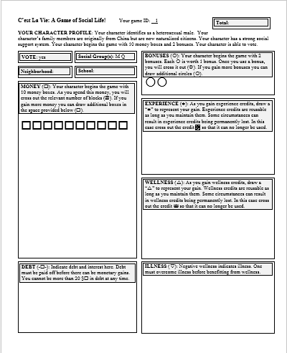
Character profiles
At this point, please open your character profile…
Notes:
Instructor activity: Distribute character profiles.
Suggested script/ verbal description: At this point, please look at your character profile. Your character profile will look similar to the one displayed on the board. On the next few slides we will quickly go through each section of the profile.

Slide 4
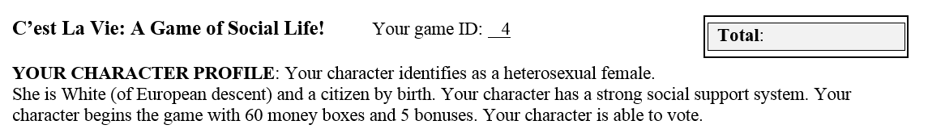
Profile descriptions
Your profile describes your character’s:
Gender and sexual orientation.
Race/ethnicity
Citizenship status
Special conditions and disabilities.
Money, bonuses, and voting status.
Notes:
Suggested script/ verbal description: The first part of your profile indicates your character’s demographic characteristics. Like many people, your character identifies with a broad racial, gender, and sexual orientation category. Your character may or may not have a disability. And your character may come from a wealthy, middle class, working class, or poor family. Your character either is or is not eligible to vote. Based on these characteristics, your character will begin the game with a certain amount of money and bonuses that can be used as resources.

Slide 5
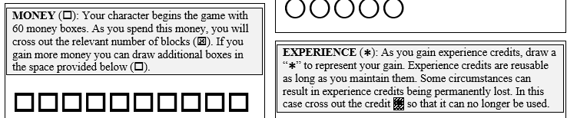
Profile descriptions
Your profile sheet also includes a space for you to record:
Money ($) and debt (--)
Bonuses ()
Experience ()
Wellness () and illness (--)
Notes:
Suggested script/ verbal description: Your profile sheet also includes a space for you to record
Money ($) and debt (--)
Bonuses ()
Experience ()
Wellness () and illness (--)
Let’s go through each of these…

Slide 6
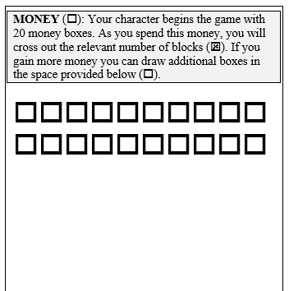
Money (□)
Each money block $ is currency that can be used to make purchases.
As you “spend” money, you will cross out the relevant number of $s.
→ $$$ = 3 spent money blocks.
Once a money block is spent, that money block cannot be used again.
If you gain more money you can draw an empty block () to represent each $ gained.
→   = +2 money blocks.
Notes:
Suggested script/ verbal description: Your character’s money is represented by money blocks. Each money block is currency that can be used to make purchases. As you “spend” this money, you will cross out the relevant number of blocks. If, for example, you want to spend three money blocks you will cross out three of the money blocks. Once a money block is “spent” that money block cannot be used again. If you gain more money you can draw an empty block to represent each money block gained. So, if you gain two money blocks, you would draw two additional blocks to represent that gain.

Slide 7
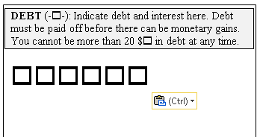
Debt (-□-)
In some situations (but not all), you may be able to use credit or a loan to make a purchase – however, interest penalties will apply.
For each money block $ that you borrow, you will draw a box under “debt”. You will also need to draw boxes to represent the interest.
As you gain money in the game, you will need to use this money to pay off your debt. Money cannot be gained until all debt is paid off.
You cannot be more than 20 $s in debt at any point in time.
Notes:
Suggested script/ verbal description: In some situations (but not all), you may be able to use credit or a loan to make a purchase – however, interest penalties will apply. For each money block $ that you borrow, you will draw a box under “debt”. You will also need to draw boxes to represent the interest. As you gain money in the game, you will need to use this money to first pay off your dept. Money cannot be gained until all debt is paid off. You cannot be more than 20 $s in total debt at any point in time (this includes debt that arises from the interest penalties). So, if you want to borrow money, and the interest is one money box for every 4 money boxes borrowed, you will only be able to borrow 16 money boxes, as the addition of the 4 boxes of interest penalties will bring your total debt up to the maximum of 20.

Slide 8
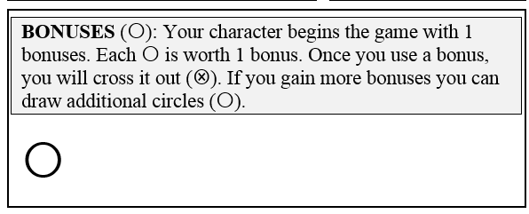
Bonuses ()
Bonuses  are “used” and “gained” similar to the money blocks
When you use a bonus, you will cross it out .
Once a bonus is used, that bonus cannot be used again.
If you gain more bonuses you can draw an empty circle () to represent the bonus.
Notes:
Suggested script/ verbal description: “Bonuses are “used” and “gained” in a similar manner as the money. As you use your bonuses, you will cross them out. The bonuses cannot be used again. If you gain a bonus, you can draw an empty circle to represent the newly gained bonus. You can only use the bonus credits that you have (unspent). It is not possible to borrow bonuses, or to go into bonus debt.

Slide 9
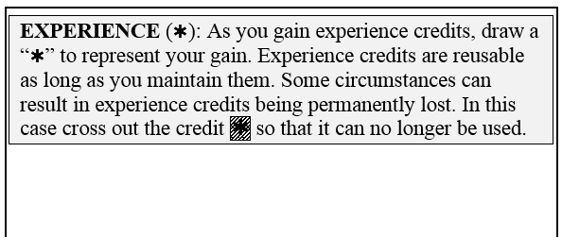
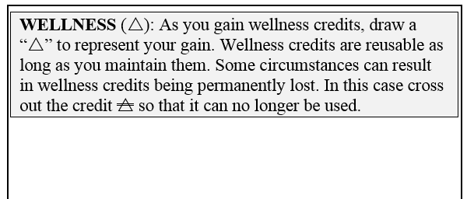
Experience () and Wellness () Credits
Experience () and Wellness () credits are gained during game play.
They are reusable. Once you have acquired them you can keep reusing them as long as you maintain them (see below).
Some circumstances can result in experience and wellness credits being permanently lost. In this case you will need to cross out the credit, , , so you know that it can no longer be used).
Notes:
Suggested script/ verbal description: Your profile card also has a place for wellness and experience credits. As you gain wellness credits and experience credits, you can add them to your profile card in these sections. Importantly, wellness and experience credits are reusable as long as you maintain them. Experience credits can help you advance in the game and wellness credits can help buffer you against illness or stress. Say, for example, that you decide to study hard to get good grades in high school. Perhaps this will earn you three experience credits. Later, if you have enough experience credits, you may earn a scholarship to go to university. In this case, you would keep your original experience credits and gain the experience credits associated with going to a university. Likewise, if you have acquired enough wellness credits, you may be able to avoid minor illness. In these situations, you get to avoid the illness, but still keep your wellness credits.
With that said, in some extreme situations it is possible to lose the wellness and experience credits that you have accumulated. For example, at certain points in your life you may “sacrifice your health or wellness” for hopeful gains in some other domain. Indeed, I am going to guess that at least a few of you in this room have studied or worked so hard that you felt the effects of stress. Or, perhaps you have “wasted your potential” by doing something that hurt, rather than helped you gain professional or educational experience. Likewise, within the game, some of the choices that you make could result in you gaining or avoiding loss in one area – but only at the expense of your wellness or experience! If this occurs, you could permanently lose some or all of your experience or wellness credits. In this case, you will need to cross out the credit so that you know that it can no longer be used as a factor in future decision scenarios.

Slide 10
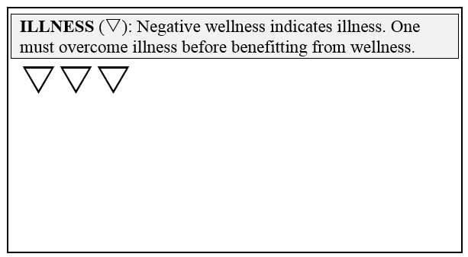
Illness (--)
Anytime that you experience negative wellness credits (you have lost more wellness credits than you have acquired), these negative wellness credits will be reflected on your score card as illness.
One must overcome illness before benefitting from wellness.
Notes:
Suggested script/ verbal description: Sometimes people use up so much of their health and wellness pursuing other goals, or they had so little health and wellness to begin with, that a major stressor, illness, or injury ends up using up all of the positive wellness that a person has remaining. In these cases people might develop chronic illness or mental health issues. If, at any point in the game, you experience negative wellness credits (that is, you have lost more wellness credits than you have acquired), you will need to reflect that deficit in the illness box. Any future gains in wellness must first be used to eliminate illness. Only once all of the illness credits are gone can your character begin to benefit from wellness credits again. There is no limitation on the amount of illness (that is negative wellness) credits that can be accumulated. However, you should know that at the end of the game any remaining illness credits will count against your point total in the game.

Slide 11

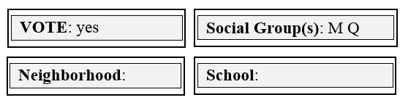
The recording sheet:
Vote: Determines whether or not your character is eligible to vote in elections.
Social groups: Membership in various groups may affect the choices available to you during game play.
Neighborhood and School: Will be determined during game play.
Total: At the end of the game you will record your total points here (more on this at the end of the game).
Notes:
Suggested script/ verbal description: Your score card also contains information on whether or not you can vote and any social group memberships for which you might belong. These factors may influence the range of your choices within the game. Early in the game, you will also make choices that determine the neighborhood that your character will live in and the school that your character will attend. These decisions can be indicated in the spaces provided. At the end of the game, your character’s accumulated resources will be converted into points. These points will be reflected in the spot on your game sheet labeled “Total.” More information on the point conversion will be provided at the end of the activity.
I know that this is a lot of information to take in at once! We will take it slowly at first, giving you a reasonable amount of time to make each choice and update your game board accordingly. Still, it is important for you to pay attention. If you lose track of your resources, you may end up spending money or bonuses that you do not have, making decisions based on the wrong information, or using wellness or experience credits that are not yours to use. Doing so could lead to missed opportunities and lost points at the end of the game. It is important that you pay attention and stay engaged throughout the activity.
Before we start to play, I have one final tip: The choices that you make early in the game can have a profound impact on the choices available to you later in the game. Make your decisions wisely and with an eye for the future! Good luck!

Slide 12

Social Group
Social group: Your character is associated with one or more social groups. These groups represent various social categories related to race (V, W, and Q), gender (V, W, M, N), sexual orientation (V, W, P), and ability/disability (V, W, S). The exact nature of these codes will be explained at the end of the game. In the meantime, you will want to pay attention to the letters printed in the Social Groups box when making certain decisions within the game.
Notes:
Suggested script/ verbal description: Your character is associated with one or more social groups. These groups represent various social categories related to race (V, W, and Q), gender (V, W, M, N), sexual orientation (V, W, P), and ability/disability (V, W, S). The exact nature of these codes will be explained at the end of the game. In the meantime, you will want to pay attention to the letters printed in the Social Groups box when making certain decisions within the game.

Slide 13

Decision 1: Neighborhood
Your character needs a place to live…
A: For 50 $s you can purchase a house in Neighborhood A, a gated community with great schools, nice parks, and private security. Gain 4 wellness credits ().
B: For 30 $s you can purchase a house in Neighborhood B with great schools, nice parks, medical facility, and a nice recreation center. Gain 3 wellness credits ().
C: For 20 $s you can rent or purchase an apartment or townhouse in Neighborhood C. OK schools, fun mix of people, good social life. Gain 2 wellness credits ().
D: For 5 $s you can rent an apartment in Neighborhood D with OK schools, OK infrastructure, and relatively low levels of crime. Gain 1 wellness credit ().
E: For $0 default to Neighborhood E with failing schools, poor infrastructure, unsafe conditions, and high levels of crime. Gain 0 wellness credits.
Use a loan: Borrow $1-9 + 1 $ interest; Borrow $10-18 + 2 $ interest
Notes:
Suggested script/ verbal description: Let’s get started! Your character needs a place to live. There are five choices displayed on the board. In a moment, I will read each choice. Based on your available resources - and your specific goals and strategies for the game - you should make the choice that you think makes the most sense for your character. Once you have made a choice you will need to
Indicate your neighborhood choice (A, B, C, D, or E) on your score sheet in the “Neighborhood” box.**
Cross off the relevant number of money boxes. If you need to borrow money, you will need to draw the appropriate debt boxes, along with the interest penalties. For example, if you borrow 8 money boxes (which falls within the 1-9 category), you need to draw the 8 debt boxes borrowed plus an additional debt box for the interest (for a total of 9 debt boxes). If you borrow 11 money boxes (which falls within the 10-18 category), you need to draw the 11 debt boxes borrowed plus an additional two debt boxes for the interest (for a total of 13 debt boxes).
Draw the number of wellness credits gained (if applicable) in the wellness section of your score sheet.
Okay, your neighborhood choices are as follows:
A: For 50 $s you can purchase a house in Neighborhood A, a gated community with great schools, nice parks, and private security. Gain 4 wellness credits ().
B: For 30 $s you can purchase a house in Neighborhood B with great schools, nice parks, medical facility, and a nice recreation center. Gain 3 wellness credits ().
C: For 20 $s you can rent or purchase an apartment or townhouse in Neighborhood C. OK schools, fun mix of people, good social life. Gain 2 wellness credits ().
D: For 5 $s you can rent an apartment in Neighborhood D with OK schools, OK infrastructure, and relatively low levels of crime. Gain 1 wellness credit ().
E: For $0 default to Neighborhood E with failing schools, poor infrastructure, unsafe conditions, and high levels of crime. Gain 0 wellness credits.
**Optional: If you are using an in-class response system to collect students’ decisions, you will also want to provide directions on how students can “click in” their responses (A, B, C, D, or E).

Slide 14

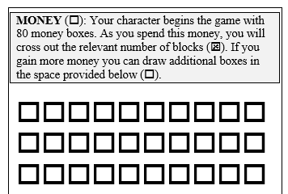
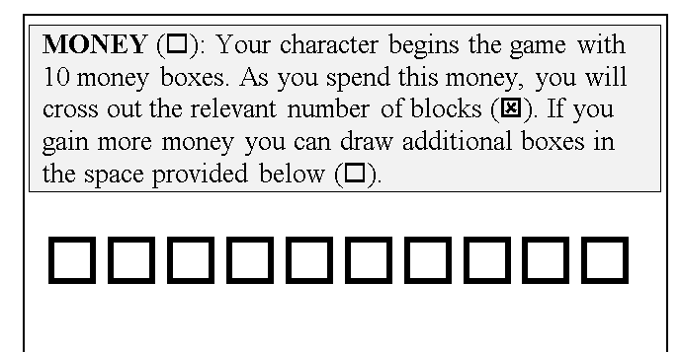
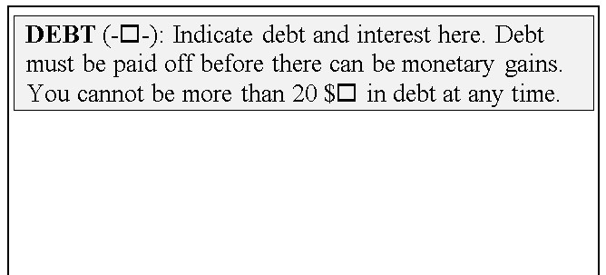
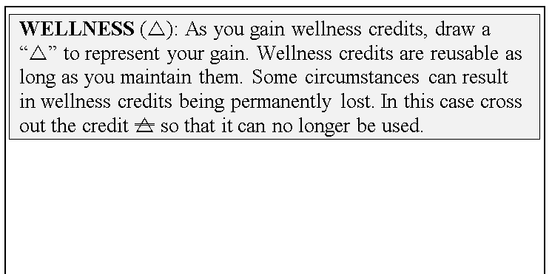

EXAMPLE: Decision 1: Neighborhood
C: For 20 $s you can rent or purchase an apartment or townhouse in Neighborhood C. OK schools, fun mix of people, good social life. Gain 2 wellness credits ().
C
C

Use a loan: Borrow $1-9 + 1 $ interest; Borrow $10-18 + 2 $ interest
Notes:
Instructor note: You can use this illustration slide if people seem to be confused about how to use the score sheet for the neighborhood decision. If everyone seems to “get it”, then this slide can be skipped.
Suggested script/ verbal description: Let’s say that you have 30 money credits (which is true with the example on the left) and you want to choose Neighborhood C. Housing in neighborhood C costs 20 money credits, so you would simply cross off 20 money credits. You would indicate your neighborhood choice by writing “C” as the neighborhood and you would also draw two triangles in the wellness box to indicate your wellness gains.
On the other hand, let’s say you did not have enough money credits to afford Neighborhood C (which is the case with the example on the right). One option would be to choose a neighborhood that you can afford. Another option is to borrow money. For example, if Neighborhood C costs 20 money credits, and you only have 10, you would cross off the 10 money boxes that you had and then you would borrow the rest. In this case, you have to borrow 10 money credits. Because a loan of 10 money credits is associated with 2 interest penalties, you would have to draw 12 debt boxes: 10 for the loan and two for the interest. You could then indicate Neighborhood “C” as your neighborhood and draw two triangles to indicate your gain in wellness.
Please note that you can only borrow up to 18 money boxes, as the 18 money boxes + 2 interest penalties would bring you to the maximum level of debt allowed. If you cannot afford a particular neighborhood within this loan range, you will have to choose housing in a neighborhood with more affordable options.
As you make your decision, do not forget to (1) Write your neighborhood choice in the neighborhood box, (2) cross out the relevant number of money boxes and add loan boxes, as applicable, and (3) draw the applicable number of triangles to represent your wellness gain(s), if applicable.

Slide 15

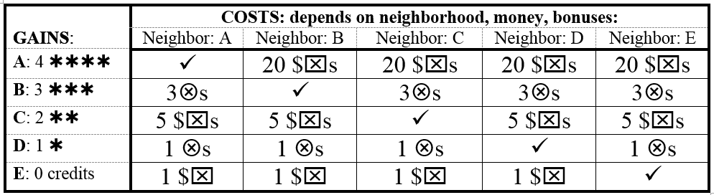
Decision 2: School
Your assigned school district (✓) depends on your neighborhood. If you do not want to select your neighborhood school, you can pay the tuition to attend a private school (A or C). Or you can use bonuses to gain access to another public school (B or D) through a “school choice” program. (Click in your selection, cross out the money boxes or bonuses, and add the education credits as applicable).
Use a loan (debt): Borrow $1-9 + 1 $ interest; Borrow $10-18 + 2 $ interest
Notes:
Suggested script/ verbal description: Great! Now that we have had some practice using the decision card, we can move on to our next choice. Your assigned school district depends on your neighborhood and is indicated with a check mark. For example, if you live in Neighborhood A, your default school is School A. You can attend that school for free. Likewise, those living in neighborhood “B” can attend school “B” for free. Those living in neighborhood “C” can attend school “C” for free and so on…
Each school is associated with a gain in experience credits, indicated in the column labeled “gains”. For example, School E, associated with Neighborhood “E” is associated with a gain of “0” experience credits. School “A”, associated with neighborhood “A” is associated with a gain of 4 experience credits.
If you do not like your neighborhood default school, you can opt into a different school in one of two ways. One option is that you can pay private tuition to attend a another school. For example, to attend Private School A (associated with 4 experience credits), you would pay a private tuition of 20 money credits. If you wanted to attend private school C (associated with 2 experience credits), you would pay a tuition of 5 money credits. Loans can be used to help pay private tuition, but interest penalties apply.
The other option for switching schools is to use your bonus credits to advocate for your character to be enrolled in a special program in another school. Special programs might include “school choice” options, “gifted programs”, or other specialty programs. For example, if you wish to enroll your character in a special program at school B (associated with three experience credits), you can do so by using three bonus credits to advocate for a spot. Or, you can enroll your character in a special program at School D (associated with one experience credit) by using one bonus credit.
Please indicate your school choice on the score card under “School”. Also, make sure to draw in your experience credits (if applicable). You can choose what symbol you want to represent your experience, but I recommend drawing a “star”, as it will be like giving your character a gold star in achievement. =)

Slide 16

Decision 3: First day
It’s your first day at a new school…
A: If part of Group V or W meet several people just like you. Gain 1 wellness credit ().
B: If you have 3 or more existing wellness credits () join a sports team – Gain 1 wellness credit ().
C: If you have 3 or more existing experience credits () join an academic group – Gain 1 wellness credit ().
D: For 1 bonus () use your charisma to make new friends. Gain 1 wellness credit ()
E: None of the above. Gain 0 wellness credits.
Notes:
Suggested script/ verbal description: Now that you have a school, it is time to make friends. At the top of your score sheet is a box called “Social Group”. This box lists at least one (if not more) letters. If you are part of “Group V or W”, you easily meet people just like you. You can choose option A and gain 1 wellness credit without using any of your resources. If you have built up three or more existing wellness credits OR if you have three more existing experience credits, you can join a sports team and academic group. Again, you gain one wellness credit without the need to use any of your resources. (Please note that if you qualify for either of these options you do not have to cross out any wellness or experience credits; you simply gain a wellness credit in addition to the resources that you already have.) If options A, B, and C do not apply, then you can use one bonus credit to make friends and to gain 1 wellness credit. Otherwise, you must pick option E and gain no wellness credits.

Slide 17
Decision 4: Focus your time
A: Healthy living. Gain 1 wellness credit ().
B: Study a lot. Gain 1 experience credit ().
C: Part time work. Gain 3 $s.
D: Build leadership skills. Gain 1 bonus ().
E: Sacrifice 3 wellness credits () to earn 5 $s.
Notes:
Suggested script/ verbal description: How do you want to use your free time? Choose one of the following options and record your gains. Please note, that you must have at least three existing wellness credits in order to choose Option E. If you choose option E, you permanently lose three of your wellness credits in exchange for a gain of 5 money boxes.
A: Healthy living. Gain 1 wellness credit ().
B: Study a lot. Gain 1 experience credit ().
C: Part time work. Gain 3 $s.
D: Build leadership skills. Gain 1 bonus ().
E: Sacrifice 3 wellness credits () to earn 5 $s.

Slide 18
Decision 5: Social Media
For a class assignment, you are asked to write a paper about the causes of poverty and crime. You start to pay attention to what the media, politicians, and community leaders are saying about the issue.
A: If you are a member of Group V, the dialogue is driven by members of your group who are talked about favorably. Gain 1 wellness credit ().
B: If you are a member of Group N or P, you hear members of your group being stereotyped and criticized under the guise of “family values”. Lose 2 wellness credits ().
C: If you are a member of Group Q or S politicians suggest that members of your group are lazy and living off the social system. Lose 2 wellness credits ().
D: If both options B and C apply to you (that is you are a member of Group N or P and a member of Group Q or S), lose 3 wellness credits ().
E: Buffer any wellness losses by using one bonus card ().
Notes:
Suggested script/ verbal description: For a class assignment, you are asked to write a paper about the causes of poverty and crime. You start to pay attention to what the media, politicians, and community leaders are saying about the issue. To understand the impact of this assignment, you will need to look at which social groups you belong.
A: If you are a member of Group V, the dialogue is driven by members of your group who are talked about favorably. Gain 1 wellness credit ().
B: If you are a member of Group N or P (but not Group Q or S), you hear members of your group being stereotyped and criticized under the guise of “family values”. Lose 2 wellness credits ().
C: If you are a member of Group Q or S (but not group N or P) politicians suggest that members of your group are lazy and living off the social system. Lose 2 wellness credits ().
D: If both options B and C apply to you (that is you are a member of Group N or P and a member of Group Q or S), lose 3 wellness credits ().
E: Buffer any wellness losses by using one bonus card ().
No matter to which social groups you belong, you can avoid losses to your wellness credits by choosing Option E and using one bonus credit to buffer any losses. If you do not have a bonus credit to spend, or you do not want to use your bonus credits, you must take the penalty associated with your social group. If you lose more wellness credits than you have, the difference must be indicated as illness in the illness box. (For example, if you have one wellness credit and Option D applies, then you will lose your one existing wellness credit AND you will gain two illness credits to reflect the total of three wellness credits lost.)

Slide 19
Decision 6: College Prep
Get into university preparatory classes and gain three experience credits (). Your choices and eligibility depend on your social group:
Group V or W: | Group S: | All other groups:
A. You attend School A or School B. B. You have 2+ existing experience credits () C. You use 1 bonus () to convince your counselor. D. You spend 5 $s on a tutor and prep courses#. E. None of the above. Gain 0 credits. | A. You attend School A or School B. B. You have 4+ existing experience credits () C. You use 3 bonuses () to convince your counselor. D. You spend 15 $s on a tutor and prep courses#. E. None of the above. Gain 0 credits. | A. You attend School A or School B. B. You have 3+ existing experience credits () C. You use 2 bonuses () to convince your counselor. D. You spend 10 $s on a tutor and prep courses#. E. E. None of the above. Gain 0 credits.
#Use a credit card: Borrow $1-9 + 2 $ interest; Borrow $10-16 + 4 $ interest
Notes:
Suggested script/ verbal description: You have the opportunity to take special preparatory courses to prepare you for college or university and to gain three experience credits. However, your choices and eligibility depend on your social group.
If you are a member of Group V or Group W, you are eligible to take the preparatory classes IF:
A. You attend School A or School B.
B. You have 2 or more existing experience credits ()
C. You use 1 bonus () to convince your counselor.
D. You spend 5 money credits on a tutor and prep courses.
E. If none of the above apply, you do not take preparatory classes. Gain 0 credits.
If you are a member of Group S. You are eligible to take the preparatory classes IF:
You attend school A or B.
You have four more existing experience credits ().
C. You use 3 bonuses () to convince your counselor.
D. You spend 15 $s on a tutor and prep courses#.
E. If none of the above apply, you do not take preparatory classes. Gain 0 credits.
If you are NOT a member of Group V, W, or S, then you are eligible to take the preparatory classes IF:
A. You attend School A or School B.
B. You have 3 or more existing experience credits ()
C. You use 2 bonuses () to convince your counselor.
D. You spend 10 $s on a tutor and prep courses#.
E. If none of the above apply, you do not take preparatory classes. Gain 0 credits.
For those of you choosing option C, make sure to cross out the relevant number of bonuses. For those of you considering option D, make sure to cross out the relevant number of money credits. You can go into debt to pay for the tutor and prep courses, but you will have to use a credit card. The interest penalties associated with credit card debt are typically higher than the interest penalties associated with other forms of debt. As such, if you must borrow money you must pay 2 interest penalties to borrow 1 to 9 money credits and four interest penalties to borrow 10 to 16 money credits. If you are borrowing money, make sure that you do not exceed your debt limit. If you choose options A, B, C, or D make sure to update your score card with the addition of three experience credits.

Slide 20

Collective Vote 1
Business leaders are about to make a decision that could affect the health of your neighborhood. Use 2 bonuses () to make your voice heard:
Option A: Neighborhoods A & B gain 3 wellness credits , all other neighborhoods lose 1 wellness credit ().
Option B: Neighborhood C gains 3 wellness credits , all other neighborhoods lose 1 wellness credit ().
Option C: Neighborhood D gains 3 wellness credits , all other neighborhoods lose 1 wellness credit ().
Option D: Neighborhood E gains 3 wellness credits , all other neighborhoods lose 1 wellness credit ().
E: No vote (if you do not want to use 2 ).
Notes:
Suggested script/ verbal description: This decision will be a collective decision. The winning option will apply to ALL of the class members. The scenario is as follows: Business leaders are about to make a decision that could affect the health of your neighborhood. IF you are eligible to vote (see the vote box) and you wish for your voice to be heard in this process, you must use 2 bonus credits. If you are not eligible to vote, you do not have two bonus credits, or you do not wish to use your bonus credits to participate in this decision, then you cannot vote; that is, you default to option E. Please note that even if you do not vote, the consequences of this vote will apply to EVERYONE in the class. For example, if option A wins, then everyone who lives in Neighborhoods A and B gain 3 wellness credits and everyone else will lose one wellness credit. This is true even for those who did not participate in the vote.
If you are eligible to vote and choose to do so, cross out two unused bonuses and choose one of the following options:
Option A: Neighborhoods A & B gain 3 wellness credits , all other neighborhoods lose 1 wellness credit ().
Option B: Neighborhood C gains 3 wellness credits , all other neighborhoods lose 1 wellness credit ().
Option C: Neighborhood D gains 3 wellness credits , all other neighborhoods lose 1 wellness credit ().
Option D: Neighborhood E gains 3 wellness credits , all other neighborhoods lose 1 wellness credit ().
Instructor note: If you are using an in-class response system, use it to collect votes from those who choose to participate. If possible, display the resulting vote on the screen. If not, you will need to choose another method to collect votes. If logistics allow it, you can collect a secret ballot. If not, do a hand count of those who wish to vote for Option A, B, C, or D. Only a small portion of the course will choose to participate in this vote. Whatever the majority is, the vote stands. The consequences apply to everyone in the class, whether they chose to vote or not. (If Option A wins, everyone that lives in Neighborhoods A and B gain 3 wellness credits and everyone else loses one wellness credit).

Slide 21
Decision 7: Trouble
You are out with a group of people when one of them shoplifts. Now you are all under suspicion.
Group V or W OR Neighborhood A: | Group Q: | All other groups:
A. Mistakes happen. All charges are eventually dropped. Lose one wellness credit for the inconvenience. | B: Spend 15 $s to hire a legal advocate who helps you get the charges dropped#. C: Use three bonuses (3 s) to “call in a favor” to get the charges dropped. D: Exchange three experience credits to strike a plea bargain (  ). E: Fight the charges, but lose six health credits for the stress and worry (). | B: Spend 10 $s to hire a legal advocate who helps you get the charges dropped#. C: Use two bonuses (2 s) to “call in a favor” to get the charges dropped. D: Exchange two experience credits to strike a plea bargain ( ). E: Fight the charges, but lose four health credits for the stress and worry ().
#Use a credit card: Borrow $1-9 + 2 $ interest; Borrow $10-16 + 4 $ interest
Notes:
Suggested script/ verbal description: You are out with a group of people when one of them shoplifts. Now you are all under suspicion.
If you are part of Group V or W OR you live in Neighborhood A, mistakes happen. All charges are eventually dropped. Lose one wellness credit for the inconvenience.
If you are part of Group Q, you must choose one of the following options:
A: Spend 15 $s to hire a legal advocate who helps you get the charges dropped#.
B: Use three bonuses (3 s) to “call in a favor” to get the charges dropped.
C: Exchange three experience credits to strike a plea bargain (  ).
D: Fight the charges, but lose six health credits for the stress and worry ().
For members of any other group, you must choose one of the following options:
A: Spend 10 $s to hire a legal advocate who helps you get the charges dropped#.
B: Use two bonuses (2 s) to “call in a favor” to get the charges dropped.
C: Exchange two experience credits to strike a plea bargain ( ).
D: Fight the charges, but lose four health credits for the stress and worry ().
For those who are considering hiring a legal advocate, you can use a credit card, but interest penalties apply. Make sure that you do not exceed your credit limit. If you lose more wellness credits than you have, the difference must be indicated as illness in the illness box.

Slide 22
Decision 8: Spend your time
A: Rest, relax, and recreate. Gain 1 wellness credit ().
B: #Unpaid internship! Exchange 5 $s to gain 3 experience credits (  ).
C: Part time work. Gain 3 $s.
D: Build your leadership skills. Gain 1 bonus ().
E: Give up 3 experience credits (  ) to drop out of school and work full time, gain 5 $s.
#Use a credit card: Borrow $1-9 + 2 $ interest
Notes:
Suggested script/ verbal description: Choose one of the following options and record your gains. Please note, that you must have at least three existing wellness credits in order to choose Option E. If you choose option E, you permanently lose three of your experience credits in exchange for a gain of 5 money boxes.
A: Rest, relax, and recreate. Gain 1 wellness credit ().
B: #Unpaid internship! Exchange 5 $s to gain 3 experience credits (  ).
C: Part time work. Gain 3 $s.
D: Build your leadership skills. Gain 1 bonus ().
E: Give up 3 experience credits (  ) to drop out of school and work full time, gain 5 $s.

Slide 23
Decision 9: Contamination
An environmental contaminant that causes severe respiratory illness is discovered in the building materials of some neighborhoods.
Neighborhood A or B: | All other neighborhoods and you have five or more health credits: | All other neighborhoods and you have four or fewer health credits:
A. Your neighborhood is not affected! There is no loss. | B. Your body is well enough to fight the illness. You are immune. There is no loss. | C: Use 2 bonuses () to use employee-provided medical leave while you recover from illness. D: Pay 10 $s in associated costs while you recover from illness#. E: Lose six wellness credits (or gain illness credits) () and live with a chronic disorder.
#Use a credit card: Borrow $1-9 + 2 $ interest; Borrow $10-16 + 4 $ interest
Notes:
Suggested script/ verbal description: An environmental contaminant that causes severe respiratory illness is discovered in the building materials of some neighborhoods.
If you are part of Neighborhood A or B: Your neighborhood is not affected! There is no loss.
If you live in Neighborhood C, D, or E and you have five or more health credits: Your body is well enough to fight the illness. You are immune. There is no loss.
If you live in Neighborhood C, D, or E and you have four or fewer health credits:
C: Use 2 bonuses () to use employee-provided medical leave while you recover from illness.
D: Pay 10 $s in associated costs while you recover from illness#.
E: Lose six wellness credits (or gain illness credits) () and live with a chronic disorder.
If you lose more wellness credits than what you have, the difference must be indicated as illness in the illness box.

Slide 24
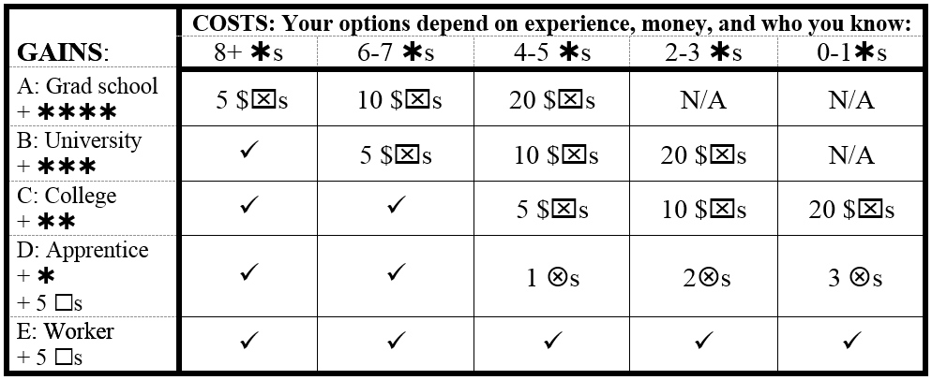
Decision 10: After Graduation
You have reached early adulthood. What will you do?
Student Loan: Borrow $1-9 + 1 $ interest; Borrow $10-18 + 2 $ interest
Notes:
Suggested script/ verbal description: You have reached early adulthood. From high school you could go on to earn a college degree (gain two experience credits), a university degree (gain three experience credits), or perhaps you will go onto graduate school after earning a university degree (gain four experience credits). Or, you might enter the work force right away, perhaps with a skilled internship (gain 5 money credits and one experience credit) or with an entry level, minimum wage position (gain 5 money credits). Your next steps will depend on your level of experience and your resources. First, count your existing experience credits. (Do not count any experience credits which you have permanently lost.) Now, find the column on the table that corresponds to your existing credits. Options indicated with a check mark (✓) are openly available to you, without the need to expend any resources. Options indicated with N/A indicate that the option is not available to you, no matter how many resources you spend. Other options may require that you spend money on tuition in order to pursue that option. Or you may have to use bonus credits to “call in a favor” to someone who can “put in a good word” on your behalf.
If you have 8 or more experience credits:
All options are available to you, but you will need to spend 5 money credits if you wish to pursue graduate school.
If you have 6 or 7 experience credits:
All options are available to you, but you will need to spend 5 money credits to go to university or 10 money credits to go to graduate school.
If you have 4 or 5 experience credits:
All options are available to you, but you will need to use a bonus credit to acquire an apprenticeship, spend 5 money credits to go to college, spend 10 money credits to go to university, or spend 20 money credits to go to graduate school.
If you have 2 or 3 experience credits:
You can start entry level work, or use two bonus credits to acquire an apprenticeship, spend 10 money credits to go to college, or spend 20 money credits to go to university. You do not have enough experience to pursue graduate school.
If you have 0 or 1 experience credits:
You can start entry level work, or use three bonus credits to acquire an apprenticeship or spend 20 money credits to go to college. You do not have enough experience to pursue a university degree or graduate school.

Slide 25
Collective Vote 2
It is election time. IF you are eligible to vote, spend 2 $☒ OR one  to secure the proper voting documents and to advocate for your right to vote. (OR, lose out on the chance to vote).
Candidate A wants to increase the minimum wage. This candidate advocates an increase in taxes for the wealthy to pay for the increase. If this candidate wins, those with > 20 $s will lose 5 $s. Those with < 5 $s will gain 3 $s.
Candidate B wants to protect the country from government involvement. This candidate will cut taxes and decrease government programs. If this candidate wins, those with > 15 $s will gain 3 $s. Those with < 5 $s will lose 3 wellness credits ().
Candidate C is concerned about creating equal opportunity. If this candidate wins, everyone in the game will lose all of their bonus credits () ensuring that no one in the game receives special favors, above and beyond the experience they actually have.
Candidate D is concerned about reparations for past oppression. If this candidate wins, members of Group P, Q, and S will gain 1 bonus credit ().
Candidate E is happy with the status quo. If this candidate wins, everything in the game will stay the same as it currently is.
Notes:
Suggested script/ verbal description: This next decision is a collective decision. As a class, those who choose to participate will make their vote. The winning option will apply to ALL of the class members. The scenario is as follows: It is election time. IF you are eligible to vote (see the vote box) you can spent 2 money credits to secure the proper voting documents OR use 1 bonus credit to advocate for your right to vote. If you are not eligible to vote or cannot or do not want to spend 2 money boxes or 1 bonus credit to vote, then you cannot vote in this election. The winning option will apply to everyone in the class, regardless of whether you voted or not.
If you are eligible to vote and choose to vote, cross out two money credits OR one bonus and choose one of the following options:
Candidate A wants to increase the minimum wage. This candidate advocates an increase in taxes for wealthier individuals to pay for the increase. If this candidate wins, those with 20 or more unused money credits will lose 5 money credits (to pay for taxes). Those with 5 or less money credits will gain 3 money credits due to the increase in minimum wage.
Candidate B wants to protect the country from government involvement. This candidate will cut taxes and decrease government programs. If this candidate wins, those with greater than 15 money credits will gain 3 money credits in tax breaks. Those with less than 5 credits will lose 3 wellness credits due to the loss of government programs.
Candidate C is concerned about creating equal opportunity. If this candidate wins, everyone in the game will lose all of their bonus credits () ensuring that no one in the game receives special favors, above and beyond the experience they actually have.
Candidate D is concerned about reparations for past oppression. If this candidate wins, members of Group P, Q, and S will gain 1 bonus credit ().
Candidate E is happy with the status quo. If this candidate wins, everything in the game will stay the same as it currently is.
Instructor note: If you are using an in-class response system, use it to collect votes from those who choose to participate. If possible, display the resulting vote on the screen. If you do not use an in-class response system, you will need to choose another method to collect votes. If logistics allow it, you can collect a secret ballot. If not, do a hand count of those who wish to vote for Candidate A, B, C, D, or E. Whatever the majority is, the vote stands. The consequences apply to everyone in the class, whether they chose to vote or not. (If Option A wins, everyone that currently has more than 20 unused money boxes will lose 5 of those money boxes and everyone with less than 5 money boxes will gain three money boxes.)

Slide 26
Decision 11: Recreation Time
A: Rest, relax, and recreate. Gain 1 wellness credit ().
B: Internship. Gain 1 experience credit ().
C: Part time work. Gain 3 $s.
D: Build your leadership skills, network. Gain 1 bonus ().
E: Sacrifice 3 wellness credits () to earn 5 $s.
Notes:
Suggested script/ verbal description: How do you want to use your free time? Choose one of the following options and record your gains. Please note, that you must have at least three existing wellness credits in order to choose Option E (you cannot experience an increase in illness credits to choose this option). If you choose option E, you permanently lose three of your wellness credits in exchange for a gain of 5 money boxes.
A: Healthy living. Gain 1 wellness credit ().
B: Study a lot. Gain 1 experience credit ().
C: Part time work. Gain 3 $s.
D: Build leadership skills. Gain 1 bonus ().
E: Sacrifice 3 wellness credits () to earn 5 $s.

Slide 27
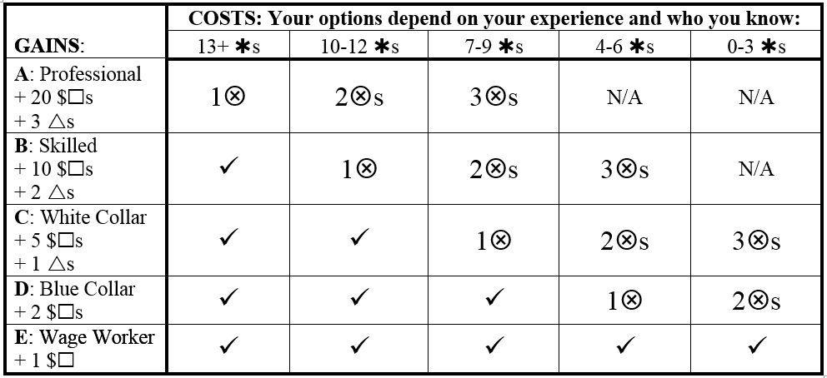
Decision 12: Career
Depending on your education and experience credits, some opportunities are automatically open to you (✓). Other opportunities may be out of reach to you (N/A). Other opportunities require that you use your bonuses () to make the right connections.
Notes:
Suggested script/ verbal description: It is time to focus on your career. The experience that you have acquired in the game so far will determine what options are available to you. First, count your existing experience credits. (Do not count any experience credits that you have permanently lost.) Now, find the column on the table that corresponds to your existing credits. Options indicated with a check mark (✓) are openly available to you, without the need to expend any resources. Options indicated with N/A indicate that the option is not available to you, no matter how many resources you spend. Other options may require that you use bonus credits to “call in a favor” to someone who can give you a good professional reference. Your career options might include working as a professional (associated with a gain in 20 money credits and 3 wellness credits), a skilled worker (associated with a gain of 10 money credits and 2 health credits), a white collar worker (associated with 5 money credits and one health credit), a blue collar worker (associated with two money credits), or a minimum wage worker (associated with 1 money credit).
If you have 13 or more experience credits:
All options are available to you, but you will need to use one bonus if you wish to pursue a professional career.
If you have 10 to 12 experience credits:
All options are available to you, but you will need to spend one bonus if you wish to pursue a skilled profession, or two bonuses to work as a professional.
If you have 7 to 9 experience credits:
All options are available to you, but you will need to use a bonus credit to secure a white collar position, two bonuses to work in a skilled profession, or three bonuses to work as a professional.
If you have 4 to 6 experience credits:
You can freely choose to work as a minimum wage worker, but you will need to use a bonus credit to secure a blue collar position, two bonuses to secure a white collar position, or three bonuses to work in a skilled profession. You do not have the experience needed to become a professional.
If you have 0 to 3 experience credits:
You can freely choose to work as a minimum wage worker, but you will need to use two bonus credits to secure a blue collar position or three bonuses to secure a white collar position. You do not have the experienced needed to become a skilled worker or a professional

Slide 28
Decision 13: Illness strikes…
A: If you have 4 or more existing wellness credits (4s), you recover quickly. No loss.
B: Use 1 bonus () to use employee-provided sick days to take a few days off for recovery.
C: Pay 5 $s to pay for medication and medical costs to help you recover from illness#.
D: Lose 2 experience credits ( ) as you miss work to recover from your illness.
E: Carry on, but lose four wellness credits (or gain illness) () as your condition worsens.
#Use a credit card: Borrow $1-9 + 2 $ interest; Borrow $10-16 + 4 $ interest
Notes:
Suggested script/ verbal description: Illness strikes. Choose one option:
A: If you have 4 or more existing wellness credits (4s), you recover quickly. No loss.
B: Use 1 bonus () to use employee-provided sick days to take a few days off for recovery.
C: Pay 5 $s to pay for medication and medical costs to help you recover from illness#.
D: Lose 2 experience credits ( ) as you miss work to recover from your illness.
E: Carry on, but lose four wellness credits () as your condition worsens.
You can use a credit card to pay for associated medical costs, but interest penalties apply. Make sure that you do not exceed your credit limit. If you lose more wellness credits than you have, the difference must be indicated as illness in the illness box.

Slide 29
Decision 14: Dating
A: If you are a member of Group M, dating is not always easy, but you almost never fear for your safety. Gain two wellness credits ().
B: If you are a member of Group N (but not S or P), safety is often in the back of your head when dating. Lose one wellness credit ().
C: If you are a member of Group S (but not P), it is difficult to find dating partners and you are often not taken serious as a sexual person. Lose three wellness credits ().
D: If you are a member of Group P (but not S), you often do not feel safe expressing your affection in public. Lose three wellness credits ().
E: If you are a member of Group S and P lose 5 wellness credits ().
Notes:
Suggested script/ verbal description:
A: If you are a member of Group M, dating is not always easy, but you almost never fear for your safety. Gain two wellness credits ().
B: If you are a member of Group N (but not S or P), safety is often in the back of your head when dating. Lose one wellness credit (). [Only choose option B if options C, D, or E do not apply.]
C: If you are a member of Group S (but not P), it is difficult to find dating partners and you are often not taken serious as a sexual person. Lose three wellness credits ().
D: If you are a member of Group P (but not S), you often do not feel safe expressing your affection in public. Lose three wellness credits ().
E: If you are a member of Group S and P lose 5 wellness credits ().

Slide 30
Decision 15: Promotion!
It’s promotion time. In order to gain 5 $□s and 3 experience credits (***) you will need to network with those making the decision…
A: If you are a Member of Group V, use one () bonus card to network and gain the promotion.
B: If you are a member of one of the following: Group N or P or Q (but not group S), use two ( ) bonus cards to network and gain the promotion.
C: If you are a member of two or more of the following: Group N or P or Q (but not group S), use three () bonus cards to network and gain the promotion.
D: If you are a member of group S, use four () bonus cards to network with the people who will make the decision.
E: Don’t have the bonus cards? Miss out on a promotion. No gain.
Notes:
Suggested script/ verbal description:
Gain 5 $s and 3 experience credits (*) if
A: If you are a Member of Group V AND you use one () bonus card to network with the people who will make the decision.
B: If you are a member of one of the following: Group N or P or Q (but not Group S), use two ( ) bonus cards to network and gain the promotion.
C: If you are a member of two or more of the following: Group N or P or Q (but not Group S), use three () bonus cards to network and gain the promotion.
D: If you are a member of Group S, use four () bonus cards to network with the people who will make the decision.
E: Don’t have the bonus cards? Miss out on a promotion. No gain.

Slide 31
Collective Vote 3
The organization that you work for is developing a new training program. If you have more than 9 experience credits vote for one of the following:
Option A is for middle level management. Individuals with 6 or more experience credits will earn 5 $ and 2 experience credits ().
Option B is a training program to advance the leadership skills of members of Group N. Members of Group N will earn 5 $ and 2 experience credits ().
Option C is a training program to advance the leadership skills of members of Group P. Members of Group P will earn 5 $ and 2 experience credits ().
Option D is a training program to advance the leadership skills of members of Group Q. Members of Group Q will earn 5 $ and 2 experience credits ().
Option E is a training program to advance the leadership skills of members of Group S. Members of Group S will earn 5 $ and 2 experience credits ().
Notes:
Suggested script/ verbal description: This next decision is a collective decision. As a class, those who choose to participate will make their vote. The winning option will apply to ALL of the class members. The scenario is as follows: It is election time. The organization that you work for is developing a new training program. If you have more than 9 experience credits vote for one of the following:
If you do not have, or want to use two bonus credits, you cannot vote. Otherwise, cross off two bonus credits and choose one of the options:
A: Option A is for middle level management. Individuals with 6 or more experience credits will earn 5 money credits and 2 experience credits ().
B: Option B is a training program to advance the leadership skills of members of Group N. Members of Group N will earn 5 money credits and 2 experience credits ().
C: Option C is a training program to advance the leadership skills of members of Group P. Members of Group P will earn 5 money credits and 2 experience credits ().
D: Option D is a training program to advance the leadership skills of members of Group Q. Members of Group Q will earn 5 money credits and 2 experience credits ().
E: Option E is a training program to advance the leadership skills of members of Group S. Members of Group S will earn a 5 money credits and 2 experience credits ().
Instructor note: If you are using an in-class response system, use it to collect votes from those who choose to participate. If possible, display the resulting vote on the screen. If you do not use an in-class response system, you will need to choose another method to collect votes. If logistics allow it, you can collect a secret ballot. If not, do a hand count of those who wish to vote for Option A, B, C, D, or E. Whatever the majority is, the vote stands. The consequences apply to everyone in the class, whether they chose to vote or not. (If Option A wins, all individuals with 6 or more experience credits, whether they voted or not, will earn 5 money credits and 2 experience credits).

Slide 32
Game over! What’s your “quality of life”?
Count up your unspent/ maintained money, bonuses, wellness, and experience credits.
Each unspent $ = 1 point (economic prosperity)
Each unused bonus,  = 1 point (prestige)
Each maintained wellness credit,  = 1 point (wellness)
Each maintained experience credit,  = 1 point (experience)
Used or lost    and  do not count for points
Financial debt and illness count against the point total (subtract the total amount of debt and illness from any positive gains).
Notes:
Suggested script/ verbal description: Count up your unspent/ maintained money, bonuses, wellness, and experience credits.
Each unspent $ = 1 point (economic prosperity)
Each unused bonus,  = 1 point (prestige)
Each maintained wellness credit,  = 1 point (wellness)
Each maintained experience credit,  = 1 point (experience)
Used or lost    and  do not count for points
Financial debt and illness count against the point total (subtract the total amount of debt and illness from any positive gains).

Slide 33
Social Groups Decoded
V = heterosexual, White, cisgender male, abled, not poor
W = heterosexual, White, cisgender female, abled, not poor
M = cisgendered, heterosexual male
N = female
P = lesbian, gay, bisexual, transgendered, transsexual
Q = racial/ethnic minority
S = physical, cognitive, mental, sensory, emotional, or developmental disability –and/or- English as a second language (ESL)

